Slide 1
GuideU
A personalized career guidance platform which takes you forward in your career and help you grow!

Slide 2

Why Us?
Students often feel overwhelmed as they may not understand which career path to choose or even identify what their strengths are and how they can shine in that particular domain.
Even if they choose a domain he/she may not get all the available resources at a single place, even if they get, they may not understand it and most of it is paid!
So we welcome you to the next-gen career guidance platform tailored just for your interests and choices, all personalized and free of cost and learn everything at your pace where traditional mentoring and guidance programs feel outdated.

Slide 3
TRENDS
The stats show that the demand for paid coursed online have drastically declined since 2019 due to the emerging GPT’s and other tools in the market.
So why commercialize education?
We are here to give you all necessary resources and guidance all at one place with a lot of exciting things to explore.

Slide 4
How can It help You?
(wanna know a secret? its all real-time!)
Assessments and Rewards
Personalization
Roadmaps & Progress Tracking
Get Super relevant content just by throwing in your area of interests, for how much time you wanna learn things, your level of understanding,what your aiming for and leave the rest of the things for us. You’ll get great content and resources all at your feet with one single click !
The content your gonna learn with timelines and resources are all rendered as road-maps which are both visually appealing and practically achievable with real-time progress tracking. Classification of levels, easy, medium, advanced will help you even more at each checkpoint!
Tech relevant assessments are all set and ready to test your skill and understanding with certifications at each stage, and the fun part? You win rewards and goodies to keep you all GOING and motivated!

Slide 5
Roadmap
Explore
Domain specific
courses
Login/SIGNUP
Generate
PERSONALIZED
DASHBOARDs
Student
Home
(No signup)
EXPLORE ALL
COURSES (basic)

Slide 6

Takeaways
Skill enhancement
Job Ready
Enhance your skills, from beginner to expert
Market ready skill and expertise
MARKET RELEVANCE
uPSKILL
Learn Market relevant technologies and skills
Continuously upskill yourself with our up-to date courses

Slide 7

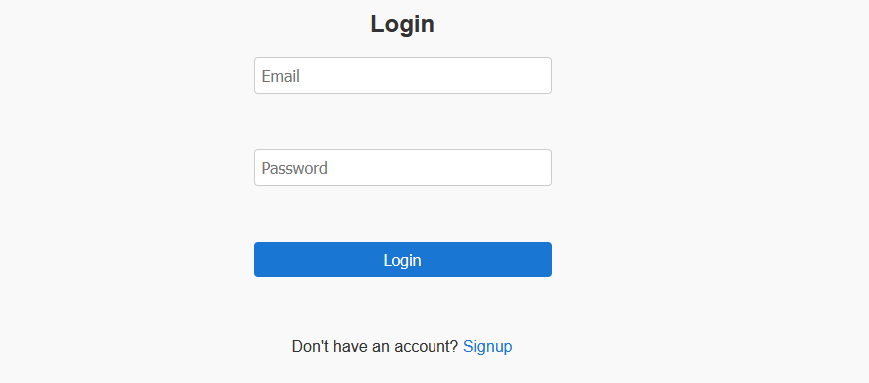
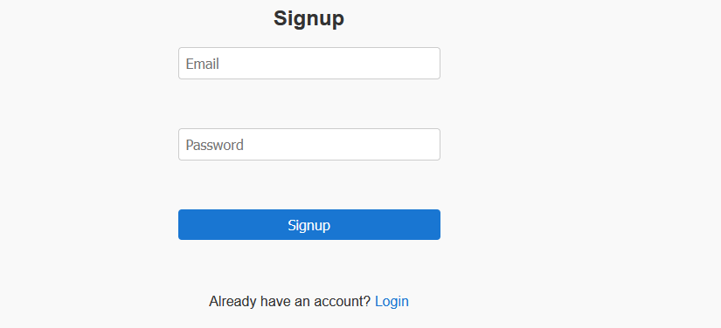
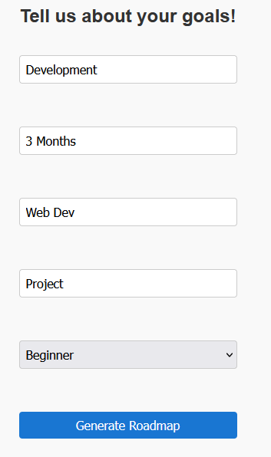
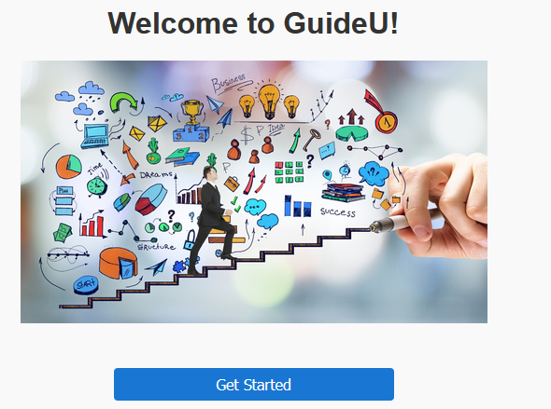
------->

Slide 8
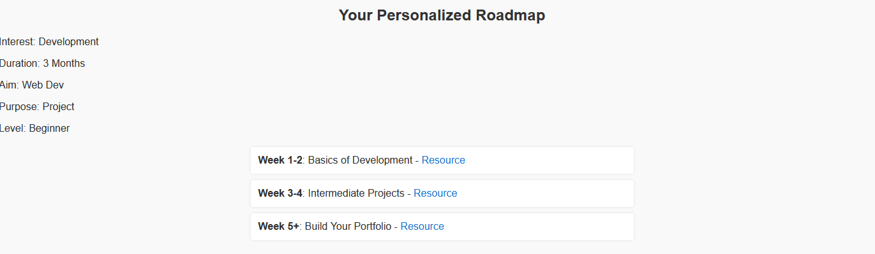

Slide 9
Thank you
N V k a sri varshini
22331a05a9

